Slide 1
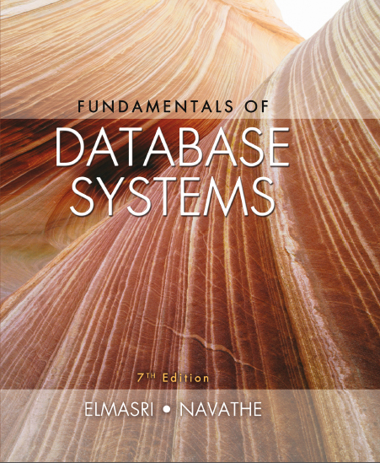
Fundamentals of Database Systems
Seventh Edition
Chapter 15
Relational Database Design Algorithms and Further Dependencies
Copyright © 2016, 2011, 2007 Pearson Education, Inc. All Rights Reserved
Notes:
If this PowerPoint presentation contains mathematical equations, you may need to check that your computer has the following installed:
1) MathType Plugin
2) Math Player (free versions available)
3) NVDA Reader (free versions available)

Slide 2
Learning Objectives (1 of 2)
15.1 Further topics in Functional Dependencies
15.1.1 Inference Rules for F D s
15.1.2 Equivalence of Sets of F D s
15.1.3 Minimal Sets of F D s
15.2 Properties of Relational Decompositions
15.3 Algorithms for Relational Database Schema Design
15.4 Nulls, Dangling Tuples, Alternative Relational Designs

Slide 3
Learning Objectives (2 of 2)
15.5 Multivalued Dependencies and Fourth Normal Form – further discussion
15.6 Other Dependencies and Normal Forms
15.6.1 Join Dependencies
15.6.2 Inclusion Dependencies
15.6.3 Dependencies based on Arithmetic Functions and Procedures
15.6.2 Domain-Key Normal Form

Slide 4
15.1 Functional Dependencies : Inference Rules, Equivalence and Minimal Cover
We discussed functional dependencies in the last chapter.
To recollect:
A set of attributes X functionally determines a set of attributes Y if the value of X determines a unique value for Y.
Our goal here is to determine the properties of functional dependencies and to find out the ways of manipulating them.

Slide 5
Defining Functional Dependencies
holds if whenever two tuples have the same value for X, they must have the same value for Y
For any two tuples t1 and t2 in any relation instance
if
in R specifies a constraint on all relation instances
Written as
can be displayed graphically on a relation schema as in Figures in Chapter 14. (denoted by the arrow:).
F D s are derived from the real-world constraints on the attributes

Slide 6
15.1.1 Inference Rules for F D s (1 of 3)
Definition: An
is inferred from or implied by
a set of dependencies F specified on R if
holds in
every legal relation state r of R; that is, whenever r
satisfies all the dependencies in F,
also holds in r.
Given a set of F D s F, we can infer additional F D s that hold whenever the F D s in F hold

Slide 7
Inference Rules for F D s (2 of 3)
Armstrong’s inference rules:
I R 1. (Reflexive) If Y subset-of X, then
then
I R 2. (Augmentation) If
(Notation: X Z stands for X U Z)
I R 3. (Transitive) If
and
then
I R 1, I R 2, I R 3 form a sound and complete set of inference rules
These are rules hold and all other rules that hold can be deduced from these

Slide 8
Inference Rules for F D s (3 of 3)
Some additional inference rules that are useful:
Decomposition: If X → Y Z, then X → Y and X → Z
Union: If X → Y and X → Z, then X → Y Z
Psuedotransitivity: If X → Y and W Y → Z, then W X → Z
The last three inference rules, as well as any other inference rules, can be deduced from I R 1, I R 2, and I R 3 (completeness property)

Slide 9
Closure
Closure of a set F of F D s is the set
of all F D s
that can be inferred from F
Closure of a set of attributes X with respect to F is the set
of all attributes that are functionally determined by X
can be calculated by repeatedly applying I R1, I R2, I R3
using the F D s in F

Slide 10
Algorithm to determine Closure
Algorithm 15.1. Determining
the Closure of X under F
Input: A set F of F D s on a relation schema R, and a set of attributes X, which is a subset of R.

Slide 11
Example of Closure (1 of 2)
For example, consider the following relation schema about classes held at a university in a given academic year.
CLASS (Classid, Course#, Instr_name, Credit_hrs, Text, Publisher, Classroom, Capacity).
Let F, the set of functional dependencies for the above relation include the following f.d.s:
FD1: Sectionid → Course#, Instr_name, Credit_hrs, Text, Publisher, Classroom, Capacity;
FD2: Course# → Credit_hrs;
FD3: {Course#, Instr_name} → Text, Classroom;
FD4: Text → Publisher
FD5: Classroom → Capacity
These f.d.s above represent the meaning of the individual attributes and the relationship among them and defines certain rules about the classes.

Slide 12
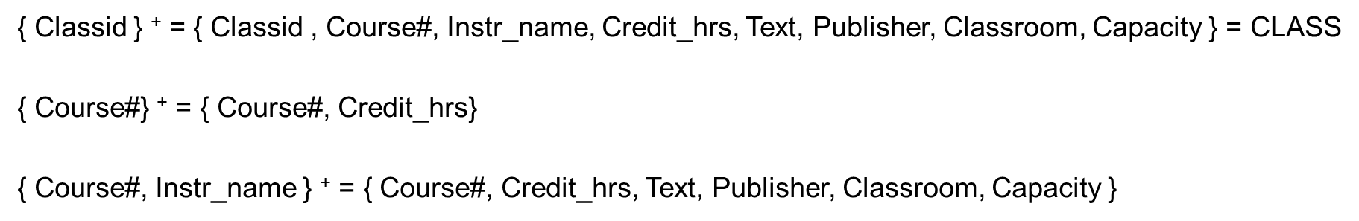
Example of Closure (2 of 2)
The closures of attributes or sets of attributes for some example sets:
Note that each closure above has an interpretation that is revealing about the attribute(s) on the left-hand-side. The closure of
is the entire relation CLASS indicating that all attributes
of the relation can be determined from Classid and hence it is a key.

Slide 13
15.1.2 Equivalence of Sets of F D s
Two sets of F D s F and G are equivalent if:
Every F D in F can be inferred from G, and
Every F D in G can be inferred from F
Hence, F and G are equivalent if
Definition (Covers):
F covers G if every F D in G can be inferred from F
F and G are equivalent if F covers G and G covers F
There is an algorithm for checking equivalence of sets of F D s

Slide 14
15.1.3 Finding Minimal Cover of F D s
Just as we applied inference rules to expand on a set F of
F D s to arrive at
its closure, it is possible to think
in the opposite direction to see if we could shrink or reduce the set F to its minimal form so that the minimal set is still equivalent to the original set F.
Definition: An attribute in a functional dependency is considered extraneous attribute if we can remove it without changing the closure of the set of dependencies. Formally, given F, the set of functional dependencies and a functional dependency X → A in F , attribute Y is extraneous in X if Y is a subset of X, and F logically implies

Slide 15
Minimal Sets of F D s (1 of 3)
A set of F D s is minimal if it satisfies the following conditions:
Every dependency in F has a single attribute for its R H S.
We cannot remove any dependency from F and have a set of dependencies that is equivalent to F.
We cannot replace any dependency X → A in F with a dependency Y → A, where Y is a proper-subset-of X and still have a set of dependencies that is equivalent to F.

Slide 16



Minimal Sets of F D s (2 of 3)
Algorithm 15.2. Finding a Minimal Cover F for a Set of Functional Dependencies E
Input: A set of functional dependencies E.
Set F:=E.
Replace each functional dependency
in F by
the n functional dependencies
For each functional dependency X → A in F
(* The above constitutes a removal of the extraneous attribute B from X *)
For each remaining functional dependency X → A in F if
is equivalent to F, then remove X → A from F.
(* The above constitutes a removal of the redundant dependency X → A from F *)

Slide 17

Computing the Minimal Sets of F D s (1 of 2)
We illustrate algorithm 15.2 with the following:
Let the given set of F D s be
we have to find the
minimum cover of E.
All above dependencies are in canonical form; so we have completed step 1 of Algorithm 10.2 and can proceed to step 2. In step 2 we need to determine if A B → D has any redundant attribute on the left-hand side; that is, can it be replaced by B → D or A → D?
Since B → A, by augmenting with B on both sides (I R 2), we have B B → A B, or B → A B (i). However, A B → D as given (ii).
Hence by the transitive rule (IR3), we get from (i) and (ii), B → D. Hence A B → D may be replaced by B → D.

Slide 18


Computing the Minimal Sets of F D s (2 of 2)
We now have a set equivalent to original E , say
No further reduction is possible
in step 2 since all F D s have a single attribute on the left-hand side.
In step 3 we look for a redundant F D in E′. By using the transitive rule on B → D and D → A, we derive B → A. Hence B → A is redundant in E’ and can be eliminated.
Hence the minimum cover of E is

Slide 19
Minimal Sets of F D s (3 of 3)
Every set of F D s has an equivalent minimal set
There can be several equivalent minimal sets
There is no simple algorithm for computing a minimal set of F D s that is equivalent to a set F of F D s. The process of Algorithm 15.2 is used until no further reduction is possible.
To synthesize a set of relations, we assume that we start with a set of dependencies that is a minimal set
E.g., see algorithm 15.4

Slide 20
Designing a Set of Relations (1 of 2)
The Approach of Relational Synthesis (Bottom-up Design):
Assumes that all possible functional dependencies are known.
First constructs a minimal set of F D s
Then applies algorithms that construct a target set of 3 N F or B C N F relations.
Additional criteria may be needed to ensure the the set of relations in a relational database are satisfactory (see Algorithm 15.3).

Slide 21
Designing a Set of Relations (2 of 2)
Goals:
Lossless join property (a must)
Algorithm 15.3 tests for general losslessness.
Dependency preservation property
Observe as much as possible
Algorithm 15.5 decomposes a relation into B C N F components by sacrificing the dependency preservation.
Additional normal forms
4 N F (based on multi-valued dependencies)
5 N F (based on join dependencies)

Slide 22
Algorithm to determine the key of a relation
Algorithm 15.2a Finding a Key K for R, given a set F of Functional Dependencies
Input: A universal relation R and a set of functional dependencies F on the attributes of R.
Set K := R;
For each attribute A in K

Slide 23
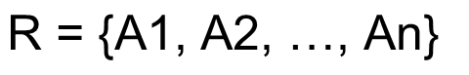
15.2 Properties of Relational Decompositions (1 of 11)
2.1 Relation Decomposition and Insufficiency of Normal Forms:
Universal Relation Schema:
A relation schema
that includes all the attributes of the database.
Universal relation assumption:
Every attribute name is unique.

Slide 24
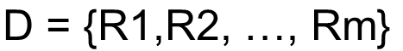
Properties of Relational Decompositions (2 of 11)
Decomposition:
The process of decomposing the universal relation schema R into a set of relation schemas
that will become the relational
database schema by using the functional dependencies.
Attribute preservation condition:
Each attribute in R will appear in at least one relation schema R_{i} in the decomposition so that no attributes are “lost”.

Slide 25
Properties of Relational Decompositions (3 of 11)
Another goal of decomposition is to have each individual relation R_{i} in the decomposition D be in B C N F or 3 N F.
Additional properties of decomposition are needed to prevent from generating spurious tuples

Slide 26
Properties of Relational Decompositions (4 of 11)
2.2 Dependency Preservation Property of a Decomposition:
Definition: Given a set of dependencies F on R, the projection of F on R_{i}, denoted by p_{Ri}(F) where R_{i} is a subset of R, is the set of dependencies X  Y in
such that the attributes in
Hence, the projection of F on each relation schema R_{i} in the decomposition D is the set of functional
dependencies in the closure of F, such that all their left- and right-hand-side attributes are in R_{i}.

Slide 27

Properties of Relational Decompositions (5 of 11)
Dependency Preservation Property of a Decomposition (cont.):
Dependency Preservation Property:
A decomposition
of R is
dependency-preserving with respect to F if the union of the projections of F on each R_{i} in D is equivalent to F; that is
(See examples in Figure 14.13a and Figure 14.12)
Claim 1:
It is always possible to find a dependency-preserving decomposition D with respect to F such that each relation R_{i} in D is in 3n f.

Slide 28
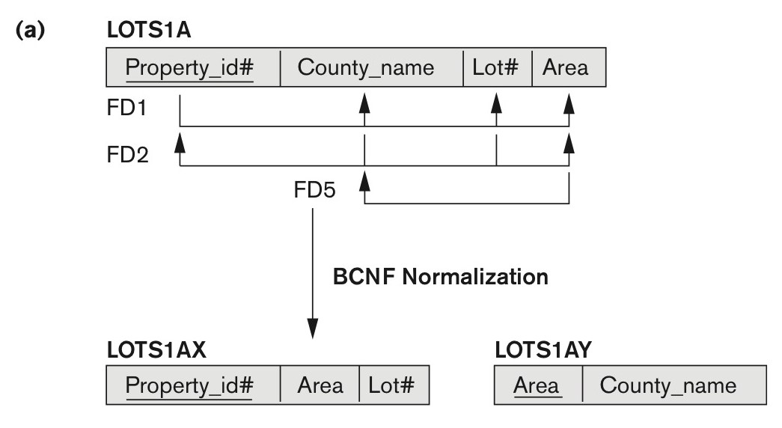
Figure 14.13a Boyce-Codd Normal Form
B C N F normalization of LOTS1A with the functional dependency F D2 being lost in the decomposition.

Slide 29
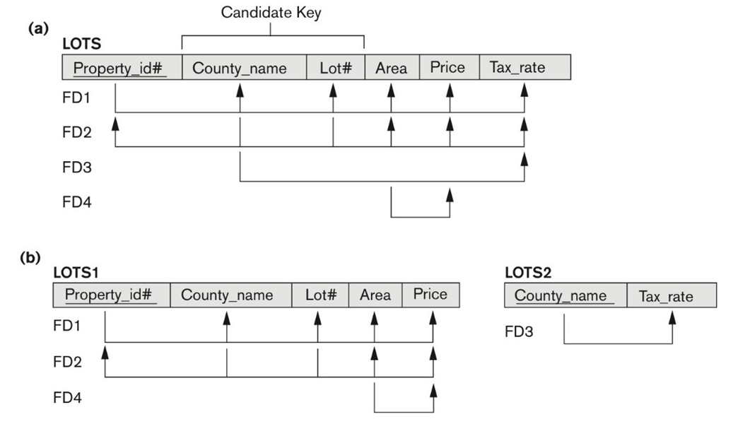
Figure 14.12 Normalization into 2N F and 3N F (1 of 2)
(a) The LOTS relation with its functional dependencies F D1 through F D4. (b) Decomposing into the 2N F relations LOTS1 and LOTS2.

Slide 30
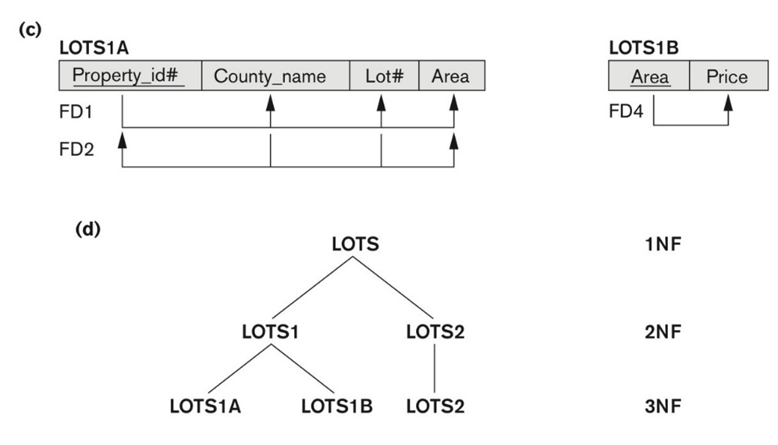
Figure 14.12 Normalization into 2N F and 3N F (2 of 2)
(c) Decomposing LOTS1 into the 3N F relations LOTS1A and LOTS1B. (d) Progressive normalization of LOTS into a 3N F design.

Slide 31

Properties of Relational Decompositions (6 of 11)
2.3 Non-additive (Lossless) Join Property of a Decomposition:
Definition: Lossless join property: a decomposition
of R has the lossless (nonadditive) join
property with respect to the set of dependencies F on R if, for every relation state r of R that satisfies F, the following holds, where * is the natural join of all the relations in D:
Note: The word loss in lossless refers to loss of information, not to loss of tuples. In fact, for “loss of information” a better term is “addition of spurious information”

Slide 32



Properties of Relational Decompositions (7 of 11)
Lossless (Non-additive) Join Property of a Decomposition :
Algorithm 15.3: Testing for Lossless Join Property
Input: A universal relation R, a decomposition
of R, and a set F of functional dependencies.
Create an initial matrix S with one row i for each relation R_{i} in D, and one column j for each attribute A_{j} in R.
for all matrix entries. (* each bij is a distinct symbol associated with indices (i,j) *).
Set
For each row i representing relation schema R_{i}
{for each column j representing attribute A_{j}
{if (relation R_{i} includes attribute A_{j}) then set
(* each a_{j} is a distinct symbol associated with index (j) *)

Slide 33
Properties of Relational Decompositions (8 of 11)
Repeat the following loop until a complete loop execution results in no changes to S
{for each functional dependency X Y in F
{for all rows in S which have the same symbols in the columns corresponding to attributes in X
{make the symbols in each column that correspond to an attribute in Y be the same in all these rows as follows:
If any of the rows has an “a” symbol for the column, set the other rows to that same “a” symbol in the column.
If no “a” symbol exists for the attribute in any of the rows, choose one of the “b” symbols that appear in one of the rows for the attribute and set the other rows to that same “b” symbol in the column ;};
};
};
If a row is made up entirely of “a” symbols, then the decomposition has the lossless join property; otherwise it does not.

Slide 34
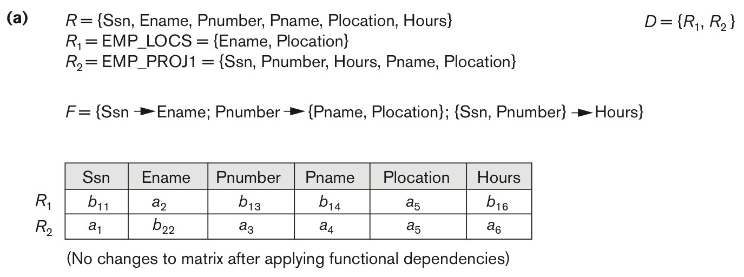
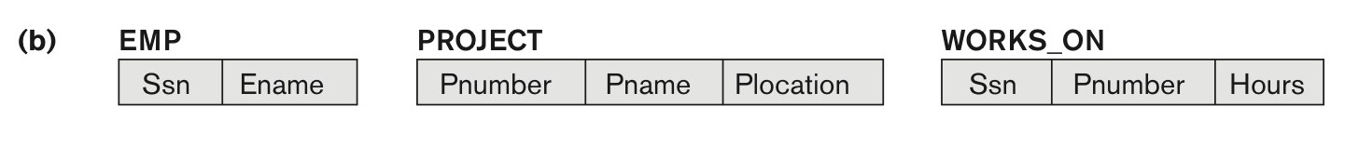
Properties of Relational Decompositions (9 of 11)
Figure 15.1 Nonadditive join test for n-ary decompositions. (a) Case 1: Decomposition of EMP_PROJ into EMP_PROJ1 and EMP_LOCS fails test. (b) A decomposition of EMP_PROJ that has the lossless join property.

Slide 35
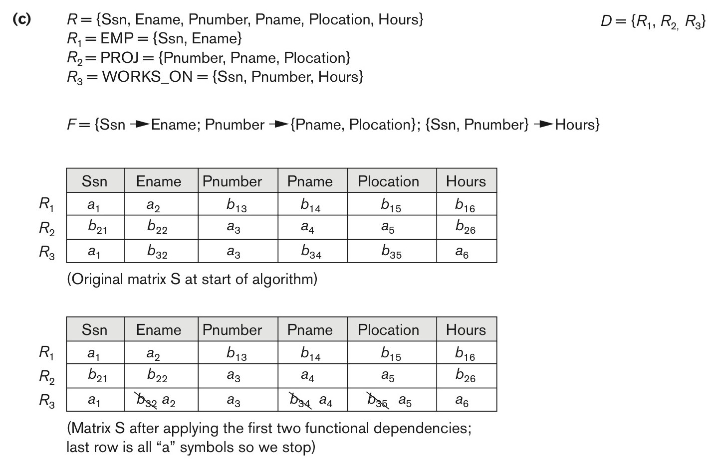
Properties of Relational Decompositions (10 of 11)
Nonadditive join test for n-ary decompositions. (Figure 15.1) (c) Case 2: Decomposition of EMP_PROJ into EMP, PROJECT, and WORKS_ON satisfies test.

Slide 36
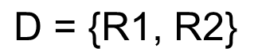
Test for checking non-additivity of Binary Relational Decompositions
2.4 Testing Binary Decompositions for Non-additive Join (Lossless Join) Property
Binary Decomposition: Decomposition of a relation R into two relations.
PROPERTY N J B (non-additive join test for binary decompositions): A decomposition
of R has the lossless join property with respect to a set of functional dependencies F on R if and only if either
The f.d.
The f.d.

Slide 37


Properties of Relational Decompositions (11 of 11)
2.5 Successive Non-additive Join Decomposition:
Claim 2 (Preservation of non-additivity in successive decompositions):
If a decomposition
of R has the
lossless (non-additive) join property with respect to a set of functional dependencies F on R,
and if a decomposition
of Ri has the
lossless (non-additive) join property with respect to the projection of F on Ri,
then the decomposition
of R has the non-additive join property with respect to F.

Slide 38

15.3 Algorithms for Relational Database Schema Design (1 of 2)
Design of 3N F Schemas:
Algorithm 15.4 Relational Synthesis into 3N F with Dependency Preservation and Non-Additive (Lossless) Join Property
Input: A universal relation R and a set of functional dependencies F on the attributes of R.
Find a minimal cover G for F (use Algorithm 15.0).
For each left-hand-side X of a functional dependency that appears in G,
create a relation schema in D with attributes
where
are the only dependencies in G
with X as left-hand-side (X is the key of this relation).
If none of the relation schemas in D contains a key of R, then create one more relation schema in D that contains attributes that form a key of R. (Use Algorithm 15.4a to find the key of R)

Slide 39
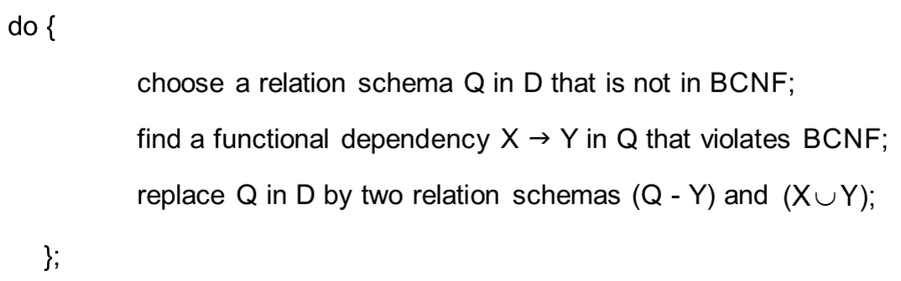
Algorithms for Relational Database Schema Design (2 of 2)
Design of B C N F Schemas
Algorithm 15.5: Relational Decomposition into B C N F with Lossless (non-additive) join property
Input: A universal relation R and a set of functional dependencies F on the attributes of R.
Set D := {R};
While there is a relation schema Q in D that is not in B C N F
Assumption: No null values are allowed for the join attributes.

Slide 40
15.4 Problems with Null Values and Dangling Tuples (1 of 5)
4.1 Problems with NULL values
when some tuples have NULL values for attributes that will be used to join individual relations in the decomposition that may lead to incomplete results.
E.g., see Figure 15.2(a), where two relations EMPLOYEE and DEPARTMENT are shown. The last two employee tuples—‘Berger’ and ‘Benitez’—represent newly hired employees who have not yet been assigned to a department (assume that this does not violate any integrity constraints).
If we want to retrieve a list of (E name, D name) values for all the employees. If we apply the NATURAL JOIN operation on EMPLOYEE and DEPARTMENT (Figure 15.2(b)), the two aforementioned tuples will not appear in the result.
In such cases, LEFT OUTER JOIN may be used. The result is shown in Figure 15.2 (c).

Slide 41
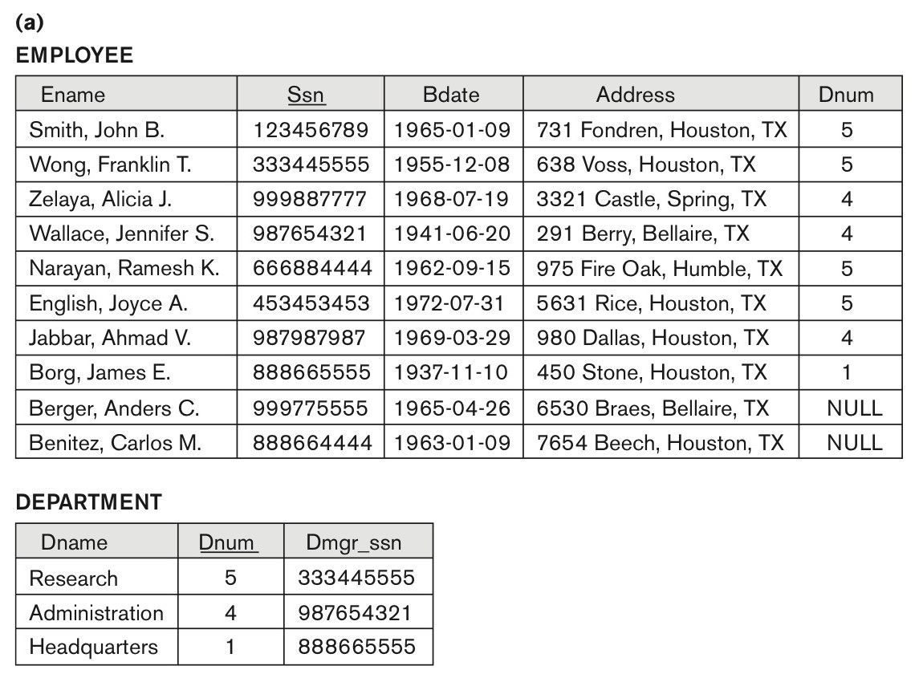
Problems with Null Values and Dangling Tuples (2 of 5)
Figure 15.2 Issues with NULL-value joins. (a) Some EMPLOYEE tuples have NULL for the join attribute D num.

Slide 42
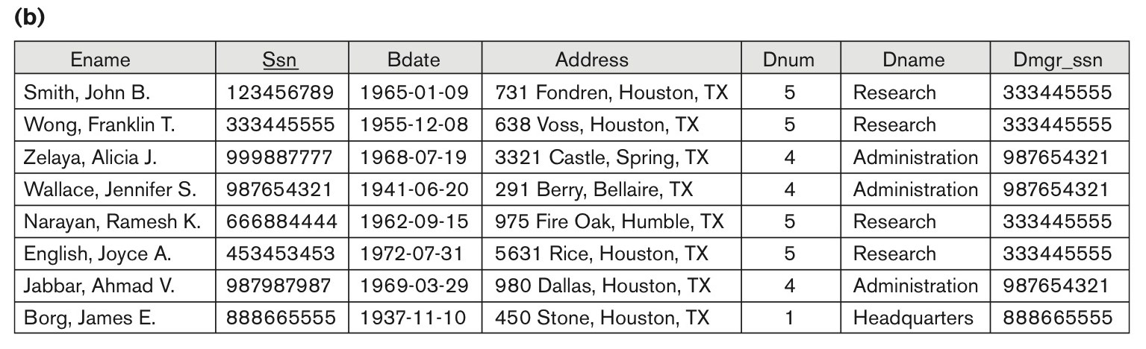
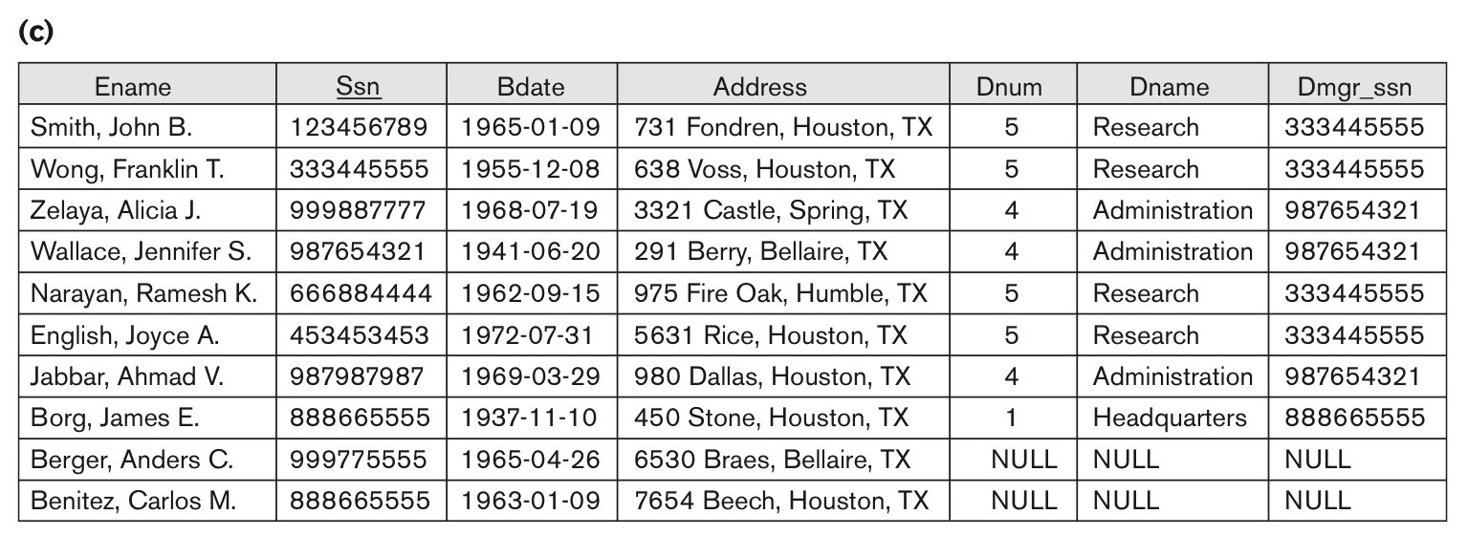
Problems with Null Values and Dangling Tuples (3 of 5)
Figure 15.2 Issues with NULL-value joins. (b) Result of applying NATURAL JOIN to the EMPLOYEE and DEPARTMENT relations. (c) Result of applying LEFT OUTER JOIN to EMPLOYEE and DEPARTMENT

Slide 43
Problems with Null Values and Dangling Tuples (4 of 5)
Problems with Dangling Tuples
Consider the decomposition of EMPLOYEE into EMPLOYEE_1 and EMPLOYEE_2 as shown in Figure 15.3 (a) and 15.3 (b).
Their NATURAL JOIN yields the original relation EMPLOYEE in Figure 15.2(a).
We may use the alternative representation, shown in Figure 15.3(c), where we do not include a tuple in EMPLOYEE_3 if the employee has not been assigned a department (instead of including a tuple with NULL for D num as in EMPLOYEE_2).
If we use EMPLOYEE_3 instead of EMPL OYEE_2 and apply a NATURAL JOIN on EMPLOYEE_1 and EMPLOYEE_3, the tuples for Berger and Benitez will not appear in the result; these are called dangling tuples in EMPLOYEE.

Slide 44
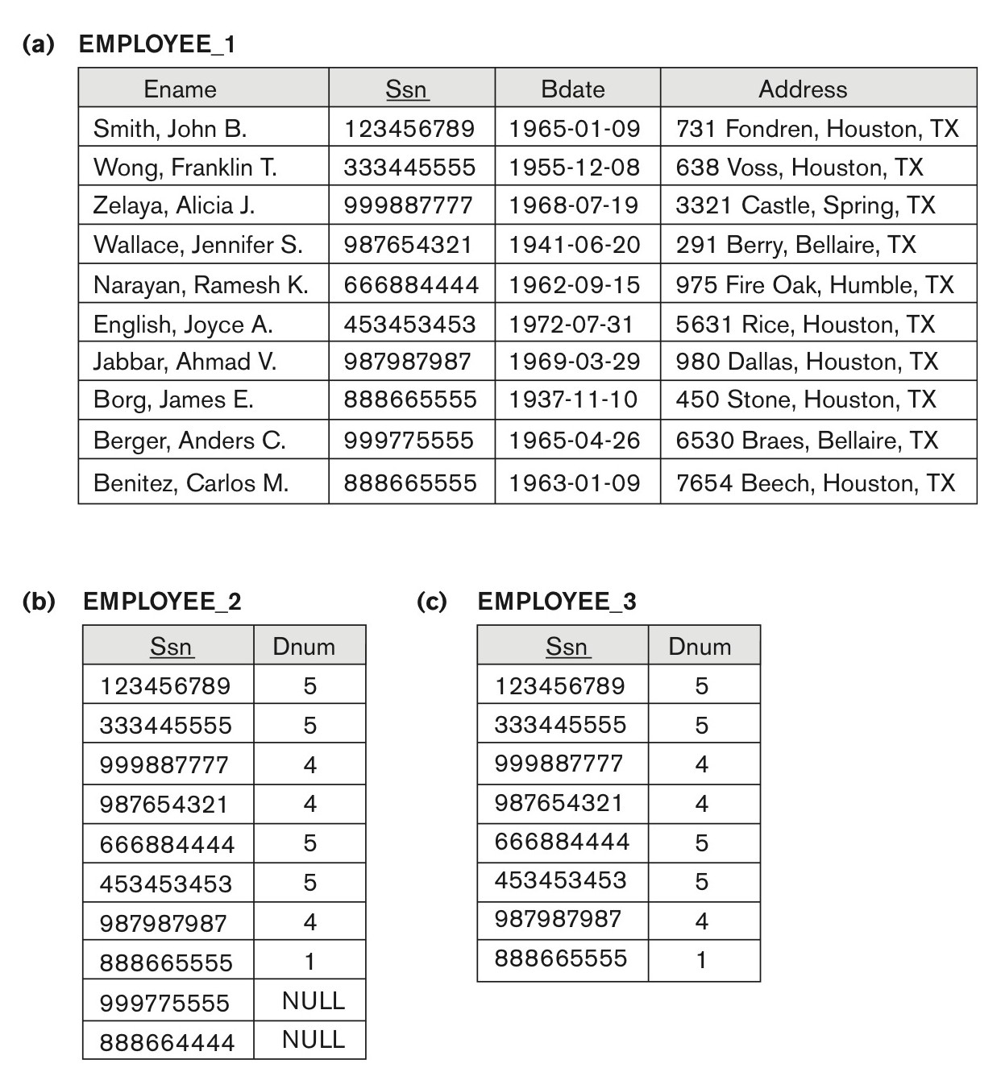
Problems with Null Values and Dangling Tuples (5 of 5)
Figure 15.3 The dangling tuple problem. (a) The relation EMPLOYEE_1 (includes all attributes of EMPLOYEE from Figure 15.2(a) except D num). (b) The relation EMPLOYEE_2 (includes D num attribute with NULL values). (c) The relation EMPLOYEE_3 (includes D num attribute but does not include tuples for which D num has NULL values).

Slide 45
About Normalization Algorithms
4.2 Discussion of Normalization Algorithms:
Problems:
The database designer must first specify all the relevant functional dependencies among the database attributes.
These algorithms are not deterministic in general.
It is not always possible to find a decomposition into relation schemas that preserves dependencies and allows each relation schema in the decomposition to be in B C N F (instead of 3 N F as in Algorithm 15.5).

Slide 46
Summary of Algorithms for Relational Database Schema Design (1 of 2)
Table 15.1 Summary of the Algorithms Discussed in This Chapter
Algorithm | Input | Output | Properties/Purpose | Remarks
15.1 | An attribute or a set of attributes X, and a set of F Ds F | A set of attributes in the closure of X with respect to F | Determine all the attributes that can be functionally determined from X | The closure of a key is the entire relation
15.2 | A set of functional dependencies F | The minimal cover of functional dependencies | To determine the minimal cover of a set of dependencies F | Multiple minimal covers may exist— depends on the order of selecting functional dependencies
15.2a | Relation schema R with a set of functional dependencies F | Key K of R | To find a key K (that is a subset of R) | The entire relation R is always a default superkey
15.3 | A decomposition D of R and a set F of functional dependencies | Boolean result: yes or no for nonadditive join property | Testing for nonadditive join decomposition | See a simpler test N J B in Section 14.5 for binary decompositions

Slide 47
Summary of Algorithms for Relational Database Schema Design (2 of 2)
Algorithm | Input | Output | Properties/Purpose | Remarks
15.4 | A relation R and a set of functional dependencies F | A set of relations in 3NF | Nonadditive join and dependencypreserving decomposition | May not achieve B C N F, but achieves all desirable properties and 3N F
15.5 | A relation R and a set of functional dependencies F | A set of relations in BCNF | Nonadditive join decomposition | No guarantee of dependency preservation
15.6 | A relation R and a set of functional and multivalued dependencies | A set of relations in 4N F | Nonadditive join decomposition | No guarantee of dependency preservation

Slide 48


15.5 Multivalued Dependencies and Fourth Normal Form – Further Discussion (1 of 6)
Definition:
A multivalued dependency (M V D) X
Y specified on relation schema R, Where X and Y are both subsets of R, specifies the following constraint on any relation state relation state r of R :
If two tuples t₁ and t₂ exist in r such that
then two tuples t₃ and t₄ should also exist in r with the following properties, where we use Z to denote
An M V D X
Y in R is called a trivial M V D if (a) Y is a subset of X, or (b)

Slide 49
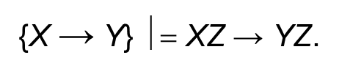






Multivalued Dependencies and Fourth Normal Form (1 of 5)
Inference Rules for Functional and Multivalued Dependencies:
I R1 (reflexive rule for F Ds):
I R2 (augmentation rule for F D s):
I R3 (transitive rule for F D s):
I R4 (complementation rule for M V D s):
I R5 (augmentation rule for M V Ds): If
I R6 (transitive rule for M V D s):
I R7 (replication rule for F D to M V D):
I R8 (coalescence rule for F D s and M V D s): If X —>> Y
and there exists W with the properties that

Slide 50
Multivalued Dependencies and Fourth Normal Form (2 of 5)
Definition:
A relation schema R is in 4 N F with respect to a set of dependencies F (that includes functional dependencies and multivalued dependencies) if, for every nontrivial multivalued dependency
Note:
is the (complete) set of all dependencies (functional
or multivalued) that will hold in every relation state r of R that satisfies F. It is also called the closure of F.

Slide 51
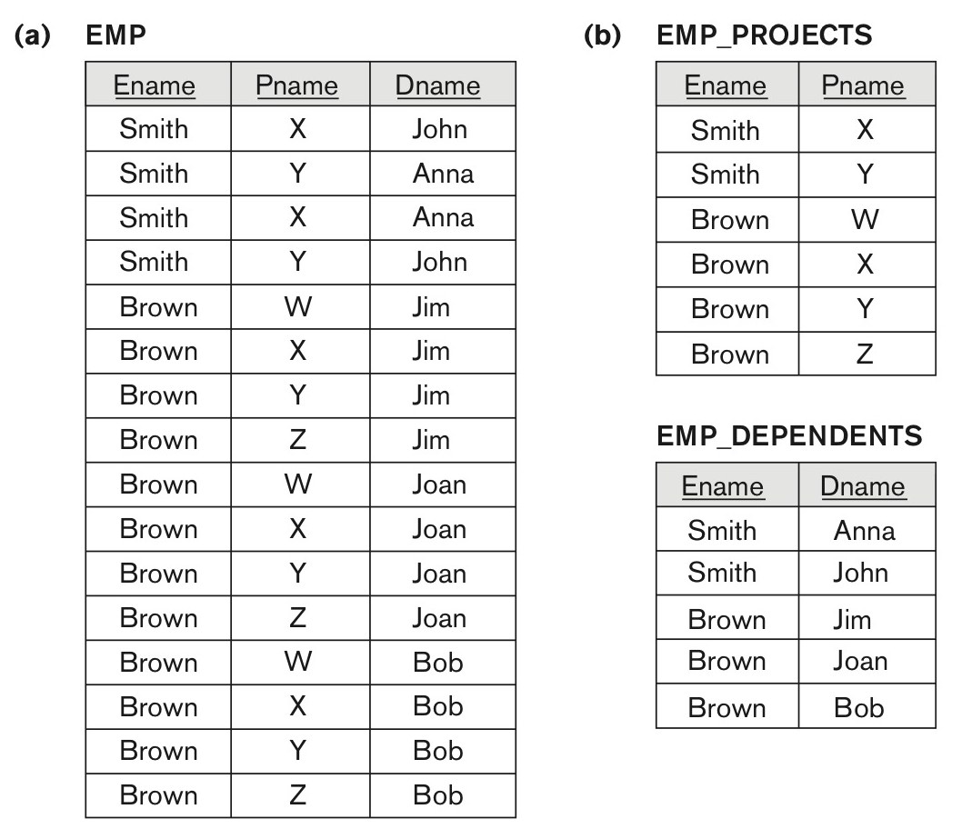
Multivalued Dependencies and Fourth Normal Form (3 of 5)
Figure 15.4 Decomposing a relation state of EMP that is not in 4 N F. (a) EMP relation with additional tuples. (b) Two corresponding 4 N F relations EMP_PROJECTS and EMP_DEPENDENTS.

Slide 52


Multivalued Dependencies and Fourth Normal Form (4 of 5)
5.3 Non-additive (Lossless) Join Decomposition into 4NF Relations:
PROPERTY NJB’
The relation schemas R₁ and R₂ form a lossless (non-additive) join decomposition of R with respect to a set F of functional and multivalued dependencies if and only if
or by symmetry, if and only if

Slide 53


Multivalued Dependencies and Fourth Normal Form (5 of 5)
Algorithm 15.7: Relational decomposition into 4N F relations with non-additive join property
Input: A universal relation R and a set of functional and multivalued dependencies F.
Set
While there is a relation schema Q in D that is not in 4N F do { choose a relation schema Q in D that is not in 4N F;
find a nontrivial M V D X
Y in Q that violates 4N F;
replace Q in D by two relation schemas (Q - Y) and
};

Slide 54




Other Dependencies and Normal Forms (1 of 2)
Join Dependency was defined in Chapter 14:
Definition:
A join dependency (J D), denoted by
specified on relation
schema R, specifies a constraint on the states r of R.
The constraint states that every legal state r of R should have a
non-additive join decomposition into
that is, for
every such r we have
Note: an M V D is a special case of a J D where n = 2.
A join dependency
specified on relation schema R, is a
trivial J D if one of the relation schemas R_{i} in
is equal to R.

Slide 55
Join Dependencies and Fifth Normal Form
Definition of 5NF:
A relation schema R is in fifth normal form (5N F) (or Project-Join Normal Form (P J N F)) with respect to a set F of functional, multivalued, and join dependencies if,
for every nontrivial join dependency
(that is, implied by F),
every R_{i} is a superkey of R.
Discovering join dependencies in practical databases with hundreds of relations is next to impossible. Therefore, 5 N F is rarely used in practice.

Slide 56
Inclusion Dependencies (1 of 2)
Definition:
An inclusion dependency R.X < S.Y between two sets of attributes—X of relation schema R, and Y of relation schema S—specifies the constraint that, at any specific time when r is a relation state of R and s a relation state of S, we must have
Note:
The
(subset) relationship does not necessarily have to be a proper subset.
The sets of attributes on which the inclusion dependency is specified—X of R and Y of S—must have the same number of attributes.
In addition, the domains for each pair of corresponding attributes should be compatible.

Slide 57


Inclusion Dependencies (2 of 2)
Objective of Inclusion Dependencies:
To formalize two types of interrelational constraints which cannot be expressed using F.D.s or M V D s:
Referential integrity constraints
Class/subclass relationships
Inclusion dependency inference rules
I D I R 1 (reflexivity): R.X < R.X.
I D I R 2 (attribute correspondence): If R.X < S.Y
where
and A_{i} Corresponds-to B_{i}, then R.A_{i} < S.B_{i}
for
I D I R 3 (transitivity): If R.X < S.Y and S.Y < T.Z, then R.X < T.Z.

Slide 58
Functional Dependencies based on Arithmetic functions and procedures (1 of 2)
Arithmetic Functions:
As long as a unique value of Y is associated with every X, we can still consider that the F D X → Y exists.
For example, consider the relation:
ORDER_LINE (Order#, Item#, Quantity, Unit_price,
Extended_price, Discounted_price)
each tuple represents an item from an order with a particular quantity, and the price per unit for that item. In this relation,
(Quantity, Unit_price ) → Extended_price by the formula Extended_price = Quantity * Unit_price .
Hence, there is a unique value for Extended_price for every pair (Quantity, Unit_price ), and thus it conforms to the definition of functional dependency.

Slide 59
Functional Dependencies based on Arithmetic functions and procedures (2 of 2)
Procedures:
There may be a procedure that takes into account the quantity discounts, the type of item, and so on and computes a discounted price for the total quantity ordered for that item. Therefore, we can say
(Item#, Quantity, Unit_price ) → Discounted_price, or
(Item#, Quantity, Extended_price) → Discounted_price.

Slide 60
Other Dependencies and Normal Forms (2 of 2)
6.4 Domain-Key Normal Form (D K N F):
Definition:
A relation schema is said to be in D K N F if all constraints and dependencies that should hold on the valid relation states can be enforced simply by enforcing the domain constraints and key constraints on the relation.
The idea is to specify (theoretically, at least) the “ultimate normal form” that takes into account all possible types of dependencies and constraints. .
For a relation in D K N F, it becomes very straightforward to enforce all database constraints by simply checking that each attribute value in a tuple is of the appropriate domain and that every key constraint is enforced.
The practical utility of D K N F is limited

Slide 61
Recap
Functional Dependencies Revisited
Designing a Set of Relations by Synthesis
Properties of Relational Decompositions
Algorithms for Relational Database Schema Design in 3 N f and B C N F
Multivalued Dependencies and Fourth Normal Form
Other Dependencies and Normal Forms

Slide 62

Copyright

